Slide 1
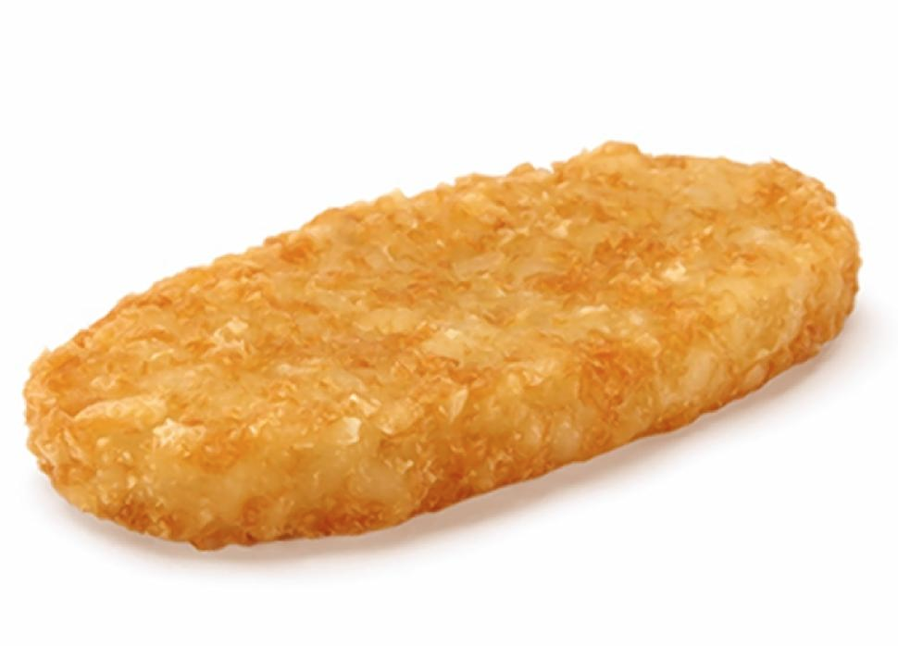
Hash Tables
Lecture 19
CS61B, Spring 2024 @ UC Berkeley
Slides Credit: Josh Hug

Slide 2
Motivation, Set Implementations
Motivation, Set Implementations
Deriving Hash Tables
WriteItOnTheWallSet
BobaCounterSet
DynamicArrayOfListsSet
lowercase strings
Integer Overflow
Hash Codes
Hash Tables in Java
Hash Table Performance and Summary
Creating a Good Hash Code (extra)
Linear Probing (extra)
Lecture 19, CS61B, Spring 2024

Slide 3
Sets
We’ve now seen several implementations of the Set (or Map) ADT.
Set
Map
ArraySet
BST
2-3 Tree
LLRB
Worst case runtimes
 | contains(x) | add(x) | Notes
ArraySet | Θ(N) | Θ(N)
BST | Θ(N) | Θ(N) | Random trees are Θ(log N).
2-3 Tree | Θ(log N) | Θ(log N) | Beautiful idea. Very hard to implement.
LLRB | Θ(log N) | Θ(log N) | Maintains bijection with 2-3 tree. Hard to implement.

Slide 4
Limits of Search Tree Based Sets
Our search tree based sets require items to be comparable.
Need to be able to ask “is X < Y?” Not true of all types (ex. How do you compare 苹 and 橙?).
Could we somehow avoid the need for objects to be comparable?
Our search tree sets have excellent performance, but could maybe be better?
Θ(log N) is amazing. 1 billion items is still only height ~30.
Could we somehow do better than Θ(log N)?
Today we’ll see the answer to both of the questions above is yes.

Slide 5
WriteItOnTheWallSet
Motivation, Set Implementations
Deriving Hash Tables
WriteItOnTheWallSet
BobaCounterSet
DynamicArrayOfListsSet
lowercase strings
Integer Overflow
Hash Codes
Hash Tables in Java
Hash Table Performance and Summary
Creating a Good Hash Code (extra)
Linear Probing (extra)
Lecture 19, CS61B, Spring 2024

Slide 6
Data Structures Reflect Real Life
Data Structures tend to be analogous to real-life things, so it's often useful to try playing the role of a data structure as a human (to get ideas on how they work)
Let's think about a simplified Set of Integers, which requires these two operations:
Add: Adds a new item to the Set
Assumption for now: We never try to add something already in the Set
Can make this assumption because we can call Contains before adding.
Contains: Checks if a given number is in the set.
Our goal is to make these operations as fast as possible.

Slide 7
WriteItOnTheWallSet
Let's introduce a human implementation of Set: WriteItOnTheWall Set
We will have a wall, and a pencil.
Add: Write the number at a random place on the wall
If the wall is full, get a bigger wall (we saw from ArrayList that this can be done in constant time amortized, so we can ignore this safely)
Contains: Look for our number on the wall. If we find it, return true. Otherwise return false
Strongly analogous to an "ArraySet"
Two questions:
Is it fast to add?
Is it fast to contains?

Slide 8
Is it fast to add: Adding "5" to a wall of 10 numbers
212 |  |  |  |  |  |  |  | 131
759 |  |  |  | 281
 |  |  |  |  |  | 670
953 |  | 984 |  |  |  |  |  | 104
 |  |  |  | 958 |  |  |  | 526

Slide 9
Is it fast to add: Adding "5" to a wall of 10 numbers
212 |  |  |  |  |  |  |  | 131
759 |  |  |  | 281
 |  |  |  |  |  | 670
953 |  | 984 |  | 5 |  |  |  | 104
 |  |  |  | 958 |  |  |  | 526

Slide 10
Is it fast to add: Adding "5" to a wall of 100 numbers
281 | 953 | 104 | 958 | 212 | 131 | 984 | 670 | 759 | 526
161 | 560 | 815 | 289 | 462 | 591 | 828 | 981 | 603 | 922
175 | 455 | 286 | 605 | 543 | 375 | 669 | 970 | 651 | 65
995 | 13 | 916 | 616 | 721 | 913 | 872 | 881 | 22 | 830
584 | 137 | 228 | 86 | 861 | 109 | 821 | 253 | 305 | 530
317 | 340 | 494 | 719 | 737 | 677 | 786 | 672 | 216 | 702
35 | 770 | 480 | 557 | 74 | 52 | 632 | 765 | 753 | 73
194 | 77 | 226 | 764 | 173 | 979 | 454 | 106 | 967 | 551
556 | 644 | 739 | 547 | 973 | 796 | 525 | 573 | 920 | 28
290 | 708 | 298 | 56 | 288 | 891 | 867 | 579 | 417

Slide 11
Is it fast to add: Adding "5" to a wall of 100 numbers
281 | 953 | 104 | 958 | 212 | 131 | 984 | 670 | 759 | 526
161 | 560 | 815 | 289 | 462 | 591 | 828 | 981 | 603 | 922
175 | 455 | 286 | 605 | 543 | 375 | 669 | 970 | 651 | 65
995 | 13 | 916 | 616 | 721 | 913 | 872 | 881 | 22 | 830
584 | 137 | 228 | 86 | 861 | 109 | 821 | 253 | 305 | 530
317 | 340 | 494 | 719 | 737 | 677 | 786 | 672 | 216 | 702
35 | 770 | 480 | 557 | 74 | 52 | 632 | 765 | 753 | 73
194 | 77 | 226 | 764 | 173 | 979 | 454 | 106 | 967 | 551
556 | 644 | 739 | 547 | 973 | 796 | 525 | 573 | 920 | 28
290 | 708 | 298 | 56 | 288 | 891 | 867 | 579 | 417 | 5

Slide 12
Is it fast to contains: Search for "439" on a wall of 10 numbers
212 |  |  |  |  |  |  |  | 131
759 |  |  |  | 281
 |  |  |  |  |  | 670
953 |  | 984 |  |  |  |  |  | 104
 |  |  |  | 958 |  |  |  | 526

Slide 13
Is it fast to contains: Search for "605" on a wall of 100 numbers
281 | 953 | 104 | 958 | 212 | 131 | 984 | 670 | 759 | 526
161 | 560 | 815 | 289 | 462 | 591 | 828 | 981 | 603 | 922
175 | 455 | 286 | 605 | 543 | 375 | 669 | 970 | 651 | 65
995 | 13 | 916 | 616 | 721 | 913 | 872 | 881 | 22 | 830
584 | 137 | 228 | 86 | 861 | 109 | 821 | 253 | 305 | 530
317 | 340 | 494 | 719 | 737 | 677 | 786 | 672 | 216 | 702
35 | 770 | 480 | 557 | 74 | 52 | 632 | 765 | 753 | 73
194 | 77 | 226 | 764 | 173 | 979 | 454 | 106 | 967 | 551
556 | 644 | 739 | 547 | 973 | 796 | 525 | 573 | 920 | 28
290 | 708 | 298 | 56 | 288 | 891 | 867 | 579 | 417 | 5

Slide 14
Is it fast to contains: Search for "605" on a wall of 100 numbers
281 | 953 | 104 | 958 | 212 | 131 | 984 | 670 | 759 | 526
161 | 560 | 815 | 289 | 462 | 591 | 828 | 981 | 603 | 922
175 | 455 | 286 | 605 | 543 | 375 | 669 | 970 | 651 | 65
995 | 13 | 916 | 616 | 721 | 913 | 872 | 881 | 22 | 830
584 | 137 | 228 | 86 | 861 | 109 | 821 | 253 | 305 | 530
317 | 340 | 494 | 719 | 737 | 677 | 786 | 672 | 216 | 702
35 | 770 | 480 | 557 | 74 | 52 | 632 | 765 | 753 | 73
194 | 77 | 226 | 764 | 173 | 979 | 454 | 106 | 967 | 551
556 | 644 | 739 | 547 | 973 | 796 | 525 | 573 | 920 | 28
290 | 708 | 298 | 56 | 288 | 891 | 867 | 579 | 417 | 5

Slide 15
Is it fast to contains: Search for "白" and "黒" on a wall of 1000 Kanji
須献資竹奈正賓方富秩苗移辞斤灯情腹縄典械迄淵執伐速寛藻具彰嗣謙役傾嘘於柵企娯李燃複主賂院雅設祥憾貌溝庁傲霊号酔旬停冖剤寡墳称遺原貧癶頻甲逮幕徒耂私素片署弧落兵坪感所農腐論眼式齢孝角略宛郎森好価認宅壁洲拐志反渋睡菓紋針縮銅蜂捨廾探確拷率夬干堂窃林鋭屮翔愚賀革月懸挑哀凵拙寝蒲以窟拒数骸頓障豕惨除体帽屏唄且狙伺膨製査用挨石釈雌投預爽繰品暑圏眺滴轄庭怠筒絞幌完築年憎莫高核煙机漬胎般擬岬販華斉遂晩社乃鈍鹿征傷縫苑沈獲重髄酌負党陸誠伊棟晶沼脱炎惚佐弊漠妖宿貿帥柴賦審飠緊散旺塊餅刺左後騰戯攵抗胸吊週症吟丸縁紳拳昇閲境披甫妨余錬謡厚井二痛渡匂白入盲淑廊攻萌蘇検使平鍛徹薪怒現笛腕賜康許舎押手矢霧悟連荘乏拠浩瓶遮員拶朱零濁辶成君囚鮮侮書柳貸鑑火恋悔朔樹偵求服廷謝尹泰坊贈去貴次救量剰慨逸制作哲駆裾血悠曹罒展対無迷福遊殊語俳端云外詩逆士忍避拭放得礁脈彑斜性飛婿底牲油職汽鬼弘隻導局惰将束粘毎妥観神妬加慮腺訟諸残痢必熊侯相根壱訴胡郷慢都系第向勧光著秀喩挿筆擦益肥籍履循勝溶析就巨渚蜜依塔咲溺席含拝慶案返揺礎紙望囗赴雑畏惧盛徐協旗爪競澄倣宜心泥止誓嚇育羅冫鼻匕吐皇到穴庄頼堀滅豆篤裏河棺甘紀省虜醸労恒把浜侍途距足迅辣呪憂亭免控還暁子恵日矛描疒互右排駒盗程玄拘畿虐咽人稼軽満営応閑聴道枢文混拾由国柔箇鉱隆別丁襲邦紫灬枠肺器勉乳菊税口整繕状呂玉恭液我塩窯仁磯脅復嘱侵悲袋親捉計杯孟磨辛挙裸胃能刷柏他誘驚那粉灰雨巣央表泡沿姻腫扉藩妻掛褐可栽藍湯叶危息殺与演弦掃橋夏当景怪合覇癖裂釜頃衤也射紡懇通彦疫崇彡層集賠換適吹忙仙漂読栓薬抜隈癒同花臨否線寄常紅蒼出箸町凝苛編恨公裁瑠欲羊刂派奪報瘍廴画或時穫色伯効討併改腸木麓秘喚宝視汚死顧漫髪保威議喪戸一然引幸摩監斐単雇羨冶汎哉脊間股評訓縦祖領待星倫腰宙柱東登弟英貝矯暇痩章医前況達治其削蚊卓陽司洋鯉凸膚句奔頂元衰殻津解建乞幣男鬱戻琴宀下毛巾忄斥斎装謂附竜兼創熟翁添繁発憧岡露殳凹説歓嫁存眠迎玩県克管悼幽艇漱決違触衆為厳理璃稽請列膝航倒条校帆屯俵棄冥亦刑組村蘭鼓門脂卵刈昆奥敷父吉丑欄塞禍低傘僅要這精飼較慌洪翌多輩追婦持鐘経漆衣難型敬母鋼渇肖猛峡俺振茨遥夕冗舛糧叔州屋覚隔誕抵犠穀隶弁損係活臓娘綱姉抑区利叱陰部叩傍亜伎両版韋夢衡基美曽民焦滑阜肪蔑記安概付湾円艦舌訂務容卜瞭契注亻芽懲優操賞唐野暫飲筈銘静酵牧扱雀調流飢冒覧予尻馴喝弄粧雷質踊便嫡慈悩褒冠棒殿着笠剛旦芋啓供警毒歩健塁証是浦

Slide 16
Is it fast to contains: Search for "白" and "黒" on a wall of 1000 Kanji
須献資竹奈正賓方富秩苗移辞斤灯情腹縄典械迄淵執伐速寛藻具彰嗣謙役傾嘘於柵企娯李燃複主賂院雅設祥憾貌溝庁傲霊号酔旬停冖剤寡墳称遺原貧癶頻甲逮幕徒耂私素片署弧落兵坪感所農腐論眼式齢孝角略宛郎森好価認宅壁洲拐志反渋睡菓紋針縮銅蜂捨廾探確拷率夬干堂窃林鋭屮翔愚賀革月懸挑哀凵拙寝蒲以窟拒数骸頓障豕惨除体帽屏唄且狙伺膨製査用挨石釈雌投預爽繰品暑圏眺滴轄庭怠筒絞幌完築年憎莫高核煙机漬胎般擬岬販華斉遂晩社乃鈍鹿征傷縫苑沈獲重髄酌負党陸誠伊棟晶沼脱炎惚佐弊漠妖宿貿帥柴賦審飠緊散旺塊餅刺左後騰戯攵抗胸吊週症吟丸縁紳拳昇閲境披甫妨余錬謡厚井二痛渡匂白入盲淑廊攻萌蘇検使平鍛徹薪怒現笛腕賜康許舎押手矢霧悟連荘乏拠浩瓶遮員拶朱零濁辶成君囚鮮侮書柳貸鑑火恋悔朔樹偵求服廷謝尹泰坊贈去貴次救量剰慨逸制作哲駆裾血悠曹罒展対無迷福遊殊語俳端云外詩逆士忍避拭放得礁脈彑斜性飛婿底牲油職汽鬼弘隻導局惰将束粘毎妥観神妬加慮腺訟諸残痢必熊侯相根壱訴胡郷慢都系第向勧光著秀喩挿筆擦益肥籍履循勝溶析就巨渚蜜依塔咲溺席含拝慶案返揺礎紙望囗赴雑畏惧盛徐協旗爪競澄倣宜心泥止誓嚇育羅冫鼻匕吐皇到穴庄頼堀滅豆篤裏河棺甘紀省虜醸労恒把浜侍途距足迅辣呪憂亭免控還暁子恵日矛描疒互右排駒盗程玄拘畿虐咽人稼軽満営応閑聴道枢文混拾由国柔箇鉱隆別丁襲邦紫灬枠肺器勉乳菊税口整繕状呂玉恭液我塩窯仁磯脅復嘱侵悲袋親捉計杯孟磨辛挙裸胃能刷柏他誘驚那粉灰雨巣央表泡沿姻腫扉藩妻掛褐可栽藍湯叶危息殺与演弦掃橋夏当景怪合覇癖裂釜頃衤也射紡懇通彦疫崇彡層集賠換適吹忙仙漂読栓薬抜隈癒同花臨否線寄常紅蒼出箸町凝苛編恨公裁瑠欲羊刂派奪報瘍廴画或時穫色伯効討併改腸木麓秘喚宝視汚死顧漫髪保威議喪戸一然引幸摩監斐単雇羨冶汎哉脊間股評訓縦祖領待星倫腰宙柱東登弟英貝矯暇痩章医前況達治其削蚊卓陽司洋鯉凸膚句奔頂元衰殻津解建乞幣男鬱戻琴宀下毛巾忄斥斎装謂附竜兼創熟翁添繁発憧岡露殳凹説歓嫁存眠迎玩県克管悼幽艇漱決違触衆為厳理璃稽請列膝航倒条校帆屯俵棄冥亦刑組村蘭鼓門脂卵刈昆奥敷父吉丑欄塞禍低傘僅要這精飼較慌洪翌多輩追婦持鐘経漆衣難型敬母鋼渇肖猛峡俺振茨遥夕冗舛糧叔州屋覚隔誕抵犠穀隶弁損係活臓娘綱姉抑区利叱陰部叩傍亜伎両版韋夢衡基美曽民焦滑阜肪蔑記安概付湾円艦舌訂務容卜瞭契注亻芽懲優操賞唐野暫飲筈銘静酵牧扱雀調流飢冒覧予尻馴喝弄粧雷質踊便嫡慈悩褒冠棒殿着笠剛旦芋啓供警毒歩健塁証是浦

Slide 17
WriteItOnTheWallSet
WriteItOnTheWallSet had fast adds (Θ(1)), but slow contains (Θ(N), where N is the number of elements)
Good thing: It didn't matter what type the items were; it worked as well with ints as it did with Kanji
How can we make this faster?
Sort the data?
Makes contains faster, but add slower (since we need to rewrite everything)
Doesn't work on Kanji
Optimizations to this leads to the TreeSet approach discussed earlier and log(N) runtime
Categorize the data?
How do we do that? Get boba.

Slide 18
BobaCounterSet
Motivation, Set Implementations
Deriving Hash Tables
WriteItOnTheWallSet
BobaCounterSet
DynamicArrayOfListsSet
lowercase strings
Integer Overflow
Hash Codes
Hash Tables in Java
Hash Table Performance and Summary
Creating a Good Hash Code (extra)
Linear Probing (extra)
Lecture 19, CS61B, Spring 2024

Slide 19
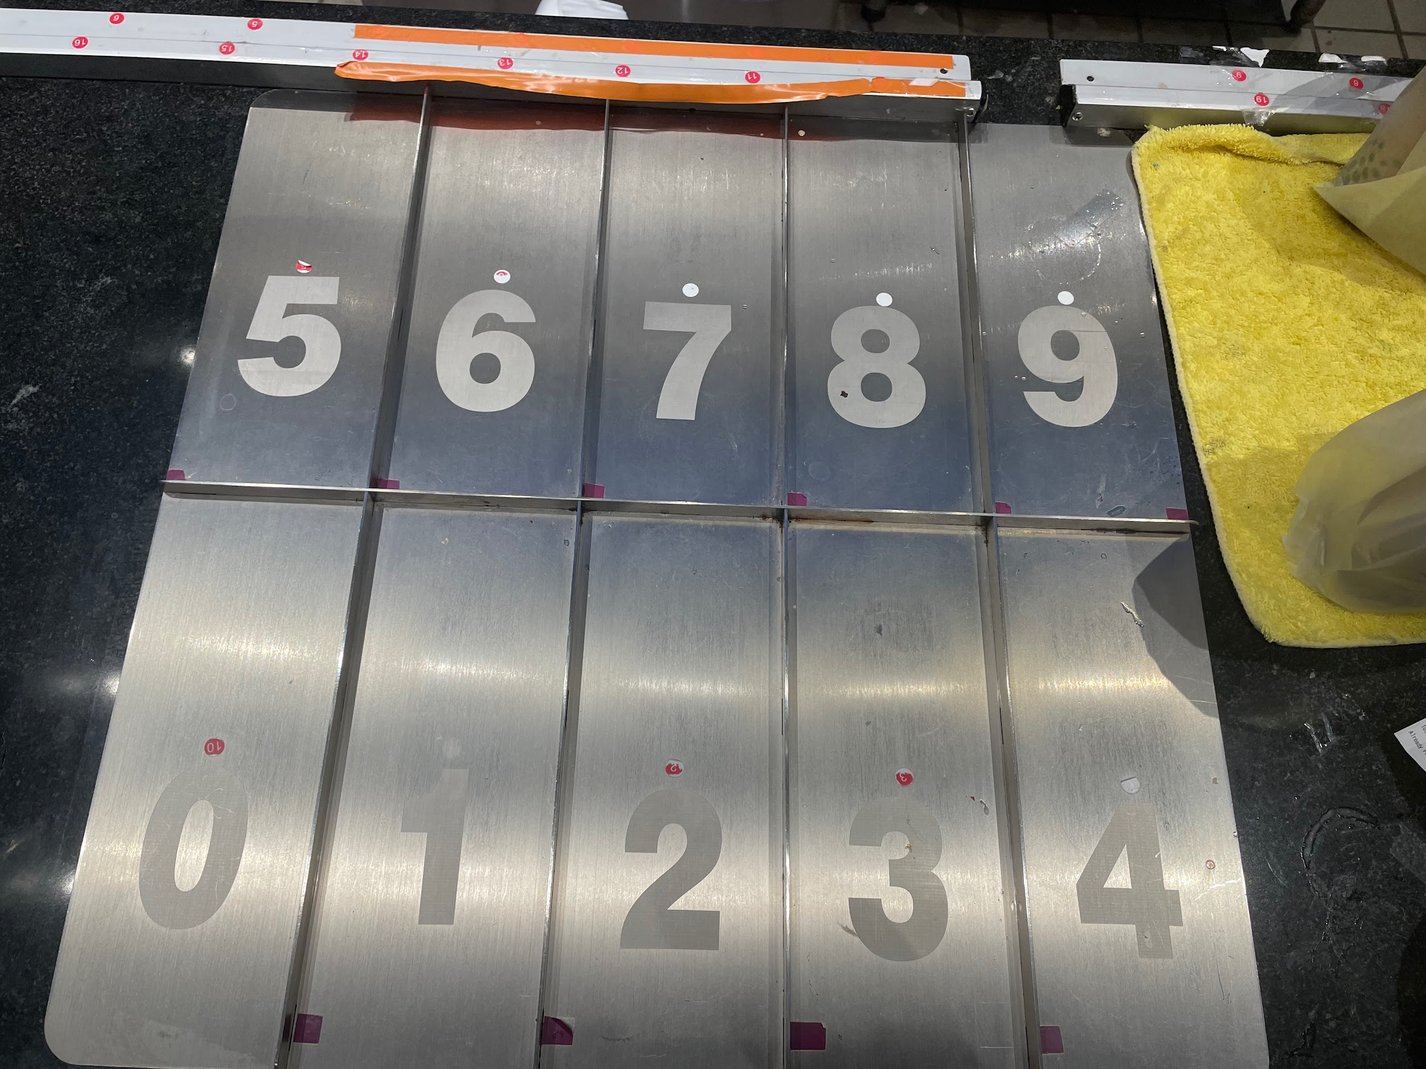
When stuck on a hard problem, get boba
TPT has this interesting device to help organize their boba
When you order boba, you get an order number
Once the boba is made, your boba gets placed on the counter for pickup
Often 5-10 boba on the counter at a time, so to avoid customers searching for their boba, so they place the boba in the slot corresponding to the last digit of your order number
Fast to add, fast to find

Slide 20
BobaCounterSet
Let's try to formalize this with a BobaCounter Set
We will have a wall split into 10 "bins", and a pencil.
Add: Write the number to the place on the wall corresponding to the last digit of the number
Ex. "193" goes in the 3 segment, "100" goes in the 0 segment
If the wall is full, get a bigger wall (we saw from ArrayList that this can be done in constant time amortized, so we can ignore this safely)
Contains: Look for our number on the wall in the bin corresponding to our last digit. If we find it, return true. Otherwise return false
Two questions:
Is it fast to add?
Is it fast to contains?

Slide 21
Is it fast to add: Adding "5" to a wall of 100 numbers
560 | 920 | 161 | 131 | 212 | 922 | 603 | 73 | 194 | 644
670 | 830 | 281 | 651 | 22 | 672 | 953 | 753 | 104 | 984
530 | 770 | 591 | 981 | 462 | 702 | 13 | 253 | 764 | 494
970 | 290 | 721 | 891 | 52 | 632 | 173 | 973 | 584 | 74
480 | 340 | 551 | 821 | 872 |  | 573 | 913 | 454
 |  | 861 | 881 |  |  | 543
765 | 375 | 216 | 556 | 737 | 677 | 288 | 828 | 109 | 669
35 | 305 | 796 | 786 | 137 | 77 | 708 | 298 | 719 | 979
65 | 995 | 226 | 86 | 557 | 967 | 228 | 28 | 739 | 579
815 | 175 | 526 | 616 | 417 | 867 | 958 |  | 289 | 759
605 | 455 | 106 | 286 | 317 | 547
525 |  | 916 | 56

Slide 22
Is it fast to add: Adding "5" to a wall of 100 numbers
560 | 920 | 161 | 131 | 212 | 922 | 603 | 73 | 194 | 644
670 | 830 | 281 | 651 | 22 | 672 | 953 | 753 | 104 | 984
530 | 770 | 591 | 981 | 462 | 702 | 13 | 253 | 764 | 494
970 | 290 | 721 | 891 | 52 | 632 | 173 | 973 | 584 | 74
480 | 340 | 551 | 821 | 872 |  | 573 | 913 | 454
 |  | 861 | 881 |  |  | 543
765 | 375 | 216 | 556 | 737 | 677 | 288 | 828 | 109 | 669
35 | 305 | 796 | 786 | 137 | 77 | 708 | 298 | 719 | 979
65 | 995 | 226 | 86 | 557 | 967 | 228 | 28 | 739 | 579
815 | 175 | 526 | 616 | 417 | 867 | 958 |  | 289 | 759
605 | 455 | 106 | 286 | 317 | 547
525 | 5 | 916 | 56

Slide 23
Is it fast to contains: Search for "605" on a wall of 100 numbers
560 | 920 | 161 | 131 | 212 | 922 | 603 | 73 | 194 | 644
670 | 830 | 281 | 651 | 22 | 672 | 953 | 753 | 104 | 984
530 | 770 | 591 | 981 | 462 | 702 | 13 | 253 | 764 | 494
970 | 290 | 721 | 891 | 52 | 632 | 173 | 973 | 584 | 74
480 | 340 | 551 | 821 | 872 |  | 573 | 913 | 454
 |  | 861 | 881 |  |  | 543
765 | 375 | 216 | 556 | 737 | 677 | 288 | 828 | 109 | 669
35 | 305 | 796 | 786 | 137 | 77 | 708 | 298 | 719 | 979
65 | 995 | 226 | 86 | 557 | 967 | 228 | 28 | 739 | 579
815 | 175 | 526 | 616 | 417 | 867 | 958 |  | 289 | 759
605 | 455 | 106 | 286 | 317 | 547
525 | 5 | 916 | 56

Slide 24
Is it fast to contains: Search for "605" on a wall of 100 numbers
560 | 920 | 161 | 131 | 212 | 922 | 603 | 73 | 194 | 644
670 | 830 | 281 | 651 | 22 | 672 | 953 | 753 | 104 | 984
530 | 770 | 591 | 981 | 462 | 702 | 13 | 253 | 764 | 494
970 | 290 | 721 | 891 | 52 | 632 | 173 | 973 | 584 | 74
480 | 340 | 551 | 821 | 872 |  | 573 | 913 | 454
 |  | 861 | 881 |  |  | 543
765 | 375 | 216 | 556 | 737 | 677 | 288 | 828 | 109 | 669
35 | 305 | 796 | 786 | 137 | 77 | 708 | 298 | 719 | 979
65 | 995 | 226 | 86 | 557 | 967 | 228 | 28 | 739 | 579
815 | 175 | 526 | 616 | 417 | 867 | 958 |  | 289 | 759
605 | 455 | 106 | 286 | 317 | 547
525 | 5 | 916 | 56

Slide 25
BobaCounterSet
BobaCounterSet still has equally fast adds, and contains is now only as slow as the wall segment with the most elements
If the numbers are random, runtime is reduced by a factor of 10
Any problems with this approach?
Since we split the wall into 10 bins, we have more wasted space. How to minimize that?
What do we do when the number of elements gets so large that even one bin has 1000 items?
What happens if the numbers aren't random (e.g. most numbers end in a 0)?
What if we want to deal with things that aren't numbers, like Kanji?

Slide 26
DynamicArrayOf ListsSet
Motivation, Set Implementations
Deriving Hash Tables
WriteItOnTheWallSet
BobaCounterSet
DynamicArrayOfListsSet
lowercase strings
Integer Overflow
Hash Codes
Hash Tables in Java
Hash Table Performance and Summary
Creating a Good Hash Code (extra)
Linear Probing (extra)
Lecture 19, CS61B, Spring 2024

Slide 27
How to minimize wasted space?
Instead of assigning the same amount of wall space per section, dynamically increase the size of each section as items get added there
Easiest solution here is to use Linked Lists
Other solutions exist, but we'll focus on the Linked List approach for this class
We still use one unit of wasted space per empty section (e.g. if 0 had no elements)
But overall, this uses less memory than before
0
1
2
3
4
5
6
7
8
9
10
11
12
3
13
4
14
5
15
6
7
8
9

Slide 28
How to handle large numbers of items?
Let N = number of items in all bins, M = number of bins
If we assume that values are evenly distributed, each bin has about N/M items
So contains runs in Θ(N/M) time.
If M is constant, that reduces to Θ(N).
Solution: Have M grow with N so that each bucket has on average a constant number of elements.
Needs a way to categorize numbers into M groups for arbitrary M: "last digit" only works with M=10.
Is there a common mathematical function that generalizes "last digit"?
0
1
2
3
4
5
6
7
8
9
10
11
12
3
13
4
14
5
15
6
7
8
9

Slide 29
Reduction Functions
Easiest solution is the "modulus" operator.
Can apply to any value of M
Evenly distributes randomly-generated numbers
Relatively prime moduli are statistically independent
Multiplying M by an integer splits each bin into smaller bins independently
Other reductions are possible, e.g. number of digits. But modulus is the most natural and best reduction function.
0
1
2
3
4
5
6
7
8
9
0
10
1034854400
Each integer gets reduced into an index.
1034854400
44
% 10
0
reduce
index
88
4178
3719
9

Slide 30
Increasing M
To keep constant time contains, we need N/M to stay less than some constant k.
Two approaches:
Increase M when the largest bin exceeds k.
Generally leads to a lot of empty bins, so not used.
Increase M when the average bin size exceeds k.
0
1
2
3
4
5
6
7
8
9
0
10
1034854400
Each integer gets reduced into an index.
1034854400
44
% 10
0
reduce
index
88
4178
3719
9

Slide 31
Increasing M
How much to increase M?
When we increase M, we'll have to reassign every number to a new box, which will take Θ(N) time during that add operation
Our goal is to have Θ(1) amortized runtime, and we've seen from ArrayLists that we can get that as long as we do Θ(N) steps rarely enough
Therefore, M should double every time we resize
0
1
2
3
4
5
6
7
8
9
0
10
1034854400
Each integer gets reduced into an index.
1034854400
44
% 10
0
reduce
index
88
4178
3719
9

Slide 32
Hash Table Resizing Example
Suppose we set a rule that when N/M is ≥ 1.5, we double M.
N = 0 M = 4 N / M = 0
0
1
2
3

Slide 33
Hash Table Resizing Example
Suppose we set a rule that when N/M is ≥ 1.5, we double M.
add(7)
N = 1 M = 4 N / M = 0.25
0
1
2
3
7

Slide 34


Hash Table Resizing Example
Suppose we set a rule that when N/M is ≥ 1.5, we double M.
add(7), add(16)
N = 2 M = 4 N / M = 0.5
0
1
2
3
16
7

Slide 35

Hash Table Resizing Example
Suppose we set a rule that when N/M is ≥ 1.5, we double M.
add(7), add(16), add(3)
N = 3 M = 4 N / M = 0.75
0
1
2
3
16
7
3

Slide 36

Hash Table Resizing Example
Suppose we set a rule that when N/M is ≥ 1.5, we double M.
add(7), add(16), add(3), add(11)
N = 4 M = 4 N / M = 1
0
1
2
3
16
7
3
11

Slide 37

Hash Table Resizing Example
Suppose we set a rule that when N/M is ≥ 1.5, we double M.
add(7), add(16), add(3), add(11), add(20)
N = 5 M = 4 N / M = 1.25
0
1
2
3
16
20
7
3
11

Slide 38

Hash Table Resizing Example
Suppose we set a rule that when N/M is ≥ 1.5, we double M.
add(7), add(16), add(3), add(11), add(20), add(13). Resize triggered.
N = 6 M = 4 N / M = 1.5
0
1
2
3
16
20
N/M is too large. Time to double!
13
7
3
11

Slide 39
Hash Table Resizing Example
When N/M is ≥ 1.5, then double M.
Draw the results after doubling M.
0
1
2
3
4
5
6
7
?
?
N = 6 M = 4 N / M = 1.5
?
N/M is too large. Time to double!
?
0
1
2
3
16
20
?
13
?
?
7
3
11
?

Slide 40
Hash Table Resizing Example
When N/M is ≥ 1.5, then double M.
Draw the results after doubling M.
N = 6 M = 8 N / M = 0.75
0
1
2
3
4
5
6
7
16
N = 6 M = 4 N / M = 1.5
0
1
2
3
16
20
N/M is too large. Time to double!
3
11
20
13
13
7
3
11
7

Slide 41
DynamicArrayOfListsSet
The data structure we just built might be called a DynamicArrayOfListsSet.
Not as intuitive as our original idea, but the core idea stayed the same
If we have N items that are evenly distributed, length of each list is ~N/M.
N/M is constant asymptotically.
So operations are constant on average.
We’ll think more carefully about runtime later.
0
1
2
3
4
5
0
6
Each integer gets reduced into an index.
146
103485440
1034854400
2133
9
46
% 6
2
DynamicArrayOfListsSet
reduce
index

Slide 42
lowercase strings
Motivation, Set Implementations
Deriving Hash Tables
WriteItOnTheWallSet
BobaCounterSet
DynamicArrayOfListsSet
lowercase strings
Integer Overflow
Hash Codes
Hash Tables in Java
Hash Table Performance and Summary
Creating a Good Hash Code (extra)
Linear Probing (extra)
Lecture 19, CS61B, Spring 2024

Slide 43
Goal: Storing Strings
The data structure we have so far is great for storing integers.
Let’s try to figure out how to store Strings of lowercase characters.

Slide 44
Storing the Word cat
Suppose we want to add(“cat”)
The key question:
Which bucket do we put “cat” in?
One idea: Use the order in the alphabet of the first letter as the list number.
a = 0, b = 1, c = 2, …, z = 25
So cat would go in bucket 2.
Forces us to start with 26 buckets
What about after resize?
After the first resize, look at the first two letters
aa = 0, ab = 1, ac = 2, …, zz = 675
cat would go in bucket 52.
What are some issues with this approach?

Slide 45
Storing the Word cat (your answer)
Suppose we want to add(“cat”)
The key question:
Which bucket do we put “cat” in?
One idea: Use the order in the alphabet of the first letter as the list number.
a = 0, b = 1, c = 2, …, z = 25
So cat would go in bucket 2.
After the first resize, look at the first two letters, then first three, and so on
What are some issues with this approach?
Not a random distribution of letters
Single-letter "a" can't be placed after resize -> extends as resizes grow

Slide 46
Storing the Word cat (my answer)
Suppose we want to add(“cat”)
The key question:
Which bucket do we put “cat” in?
One idea: Use the order in the alphabet of the first letter as the list number.
a = 0, b = 1, c = 2, …, z = 25
So cat would go in bucket 2.
After the first resize, look at the first two letters, then first three, and so on
What are some issues with this approach?
Where to put short strings (e.g. "a") after resize? (can probably fix)
It feels wrong for Strings to force our Set to resize to 26, 676, etc. buckets, when ints allowed for any number of buckets. (CRITICAL)
Are we going to have to define a new resize for every type of object???

Slide 47
Design Philosophy: Stringy stuff should be done in the String class
The big problem with the previous approach was that Set was responsible for figuring out how to categorize Strings
That shouldn't be the Set's job, since otherwise Set would have to know about every single Object in existence (including ones that aren't built yet), and how to categorize them
At the same time, String shouldn't be able to dictate when Set decides to resize
With ints, Set could decide the M/N threshold and bin multiplier, so Set could decide which values made the most sense (given memory/time constraints).
Solution: Set was most flexible when working on ints, so make it so that Set only works on ints.
Define a method f (in String) to convert Strings into an int, and store String s in the bin corresponding to f(s).
String gets to decide how it wants to be categorized, Set gets to decide when it wants to resize.

Slide 48
Finding a Way to Store the Word cat
Suppose we want to add(“cat”)
The key question:
How do I convert “cat” into a number?
What is another idea? Assume for now we’re dealing with only lower case letters in English.

Slide 49
Finding a Way to Store the Word cat (Your Answer)
Suppose we want to add(“cat”)
The key question:
How do I convert “cat” into a number?
What is another idea? Assume for now we’re dealing with only lower case letters in English.
Sum up each letter
ASCII/Unicode
Base 26
Number of characters

Slide 50
Finding a Way to Store the Word cat (My Answer)
Suppose we want to add(“cat”)
The key question:
How do I convert “cat” into a number?
What is another idea? Assume for now we’re dealing with only lower case letters in English.
Ideally we should evenly distribute Strings; we don't want any int to have significantly more associated strings than average.
Treat cat as a base 26 number.

Slide 51
Treating cat as a Base 26 Number
Use all digits by multiplying each by a power of 26.
a = 1, b = 2, c = 3, …, z = 26
Thus the index of “cat” is (3 x 26²) + (1 x 26¹) + (20 x 26⁰) = 2074.
Why this specific pattern?
Let’s review how numbers are represented in decimal.

Slide 52
The Decimal Number System vs. My System for Strings
In the decimal number system, we have 10 digits: 0, 1, 2, 3, 4, 5, 6, 7, 8, 9
Want numbers larger than 9? Use a sequence of digits.
Example: 7091 in base 10
7091₁₀ = (7 x 10³) + (0 x 10²) + (9 x 10¹) + (1 x 10⁰)
Our system for strings is almost the same, but with letters.
One difference: In decimal numbers, 000 is the same as 0, but with strings aaa is different from a.
To deal with this, we just don’t have a 0 in our system, i.e. a is 1, not 0.

Slide 53
Test Your Understanding
Convert the word “bee” into a number by using our “powers of 26” strategy.
Reminder: cat₂₆ = (3 x 26²) + (1 x 26¹) + (20 x 26⁰) = 2074₁₀
Hint: ‘b’ is letter 2, and ‘e’ is letter 5.

Slide 54
Test Your Understanding
Convert the word “bee” into a number by using our “powers of 26” strategy.
Reminder: cat₂₆ = (3 x 26²) + (1 x 26¹) + (20 x 26⁰) = 2074₁₀
Hint: ‘b’ is letter 2, and ‘e’ is letter 5.
bee₂₆ = (2 x 26²) + (5 x 26¹) + (5 x 26⁰) = 1487₁₀

Slide 55
Uniqueness
cat₂₆ = (3 x 26²) + (1 x 26¹) + (20 x 26⁰) = 2074₁₀
bee₂₆ = (2 x 26²) + (5 x 26¹) + (5 x 26⁰) = 1487₁₀
As long as we pick a base ≥ 26, this algorithm is guaranteed to give each lowercase English word a unique number!
Using base 26, no other words will get the number 1487.

Slide 56
The Hash Table
We’ve now extended our DynamicArrayOfLinkedLists to handle strings.
Data is converted by a integerization function into an integer representation.
The integer is then reduced to a valid index, usually using the modulus operator, e.g. 2348762878 % 10 = 8.
0
1
2
3
4
5
6
map
go
sad
data
Integerization Function
integer
cat
cat
lowerCaseToInt
2074
cats
horse
fish
ball
% 7
1
reduce
index
DynamicArrayOfLinkedLists

Slide 57
Implementing englishToInt (optional)
Optional exercise: Try to write a function englishToInt that can convert English strings to integers by adding characters scaled by powers of 26.
Examples:
a: 1
z: 26
aa: 27
bee: 1487
cat: 2074
dog: ??
potato: ??

Slide 58
Implementing englishToInt (optional) (solution)
/** Converts ith character of String to a letter number. * e.g. 'a' -> 1, 'b' -> 2, 'z' -> 26 */
public static int letterNum(String s, int i) {
int ithChar = s.charAt(i);
if ((ithChar < 'a') || (ithChar > 'z'))
{ throw new IllegalArgumentException(); }
return ithChar - 'a' + 1;
}
public static int englishToInt(String s) {
int intRep = 0;
for (int i = 0; i < s.length(); i += 1) {
intRep = intRep * 26;
intRep = intRep + letterNum(s, i);
}
return intRep;
}

Slide 59
Integer Overflow
Motivation, Set Implementations
Deriving Hash Tables
WriteItOnTheWallSet
BobaCounterSet
DynamicArrayOfListsSet
lowercase strings
Integer Overflow
Hash Codes
Hash Tables in Java
Hash Table Performance and Summary
Creating a Good Hash Code (extra)
Linear Probing (extra)
Lecture 19, CS61B, Spring 2024

Slide 60
DataIndexedStringSet
Using only lowercase English characters is too restrictive.
What if we want to store strings like “2pac” or “eGg!”?
Suppose we wanted a unique integer for each possible such string.
Need to assign an integer to all possible characters, e.g. what integer goes with !
Someone has already done this.
Let’s first discuss briefly discuss the ASCII standard.

Slide 61
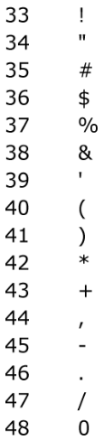
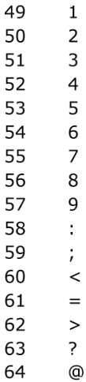
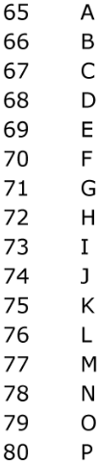
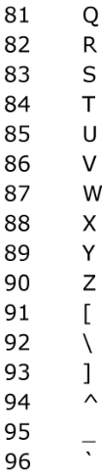
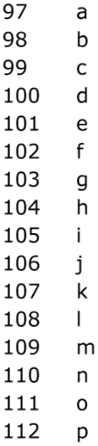
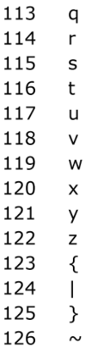
ASCII Characters
The most basic character set used by most computers is ASCII format.
Each possible character is assigned a value between 0 and 127.
Characters 33 - 126 are “printable”, and are shown below.
For example, char c = ’D’ is equivalent to char c = 68.
biggest value is 126

Slide 62
DataIndexedStringSet
Maximum possible value for english-only text including punctuation is 126, so can use 126 as our base in order to ensure unique values for all possible strings.
Examples:
bee₁₂₆= (98 x 126²) + (101 x 126¹) + (101 x 126⁰) = 1,568,675
2pac₁₂₆ = (50 x 126³) + (112 x 126²) + (97 x 126¹) + (99 x 126⁰)
=101,809,233
eGg!₁₂₆ = (98 x 126³) + (71 x 126²) + (98 x 126¹) + (33 x 126⁰)
= 203,178,213

Slide 63
Implementing asciiToInt
Below is a simple formula which converts a String to an integer.
Treats String as a base 126 number.
What if we want to use characters beyond ASCII?
public static int asciiToInt(String s) {
int intRep = 0;
for (int i = 0; i < s.length(); i += 1) {
intRep = intRep * 126;
intRep = intRep + s.charAt(i);
}
return intRep;
}

Slide 64
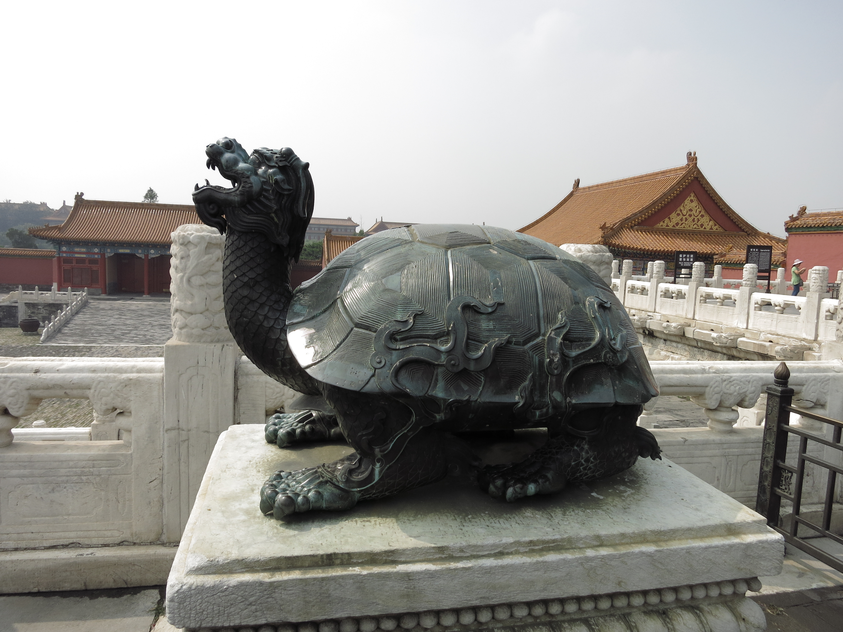
Going Beyond ASCII
chars in Java also support character sets for other languages and symbols.
char c = ’☂’ is equivalent to char c = 9730.
char c = ’鳌’ is equivalent to char c = 40140.
char c = ’혜’ is equivalent to char c = 54812.
This encoding is known as Unicode. Table is too big to list.

Slide 65
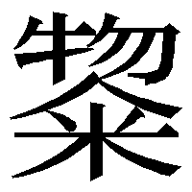
Example: Computing Unique Representations of Kanji
The largest possible value for Kanji is 40,959*, so we’d need to use this as our base if we want to have a unique representation for all possible strings of Kanji.
Example:
横田誠司₄₀₉₅₉ = (27178 x 40959³) + (30000 x 40959²) + (35488 x 40959¹) + (21496 x 40959⁰) = 1,867,571,481,361,683,550
...
...
横田誠号
横田誠司
横田誠叹
1,867,571,481,361,683,549
1,867,571,481,361,683,550
1,867,571,481,361,683,551
...
...
*If you’re curious, the last character is:

Slide 66
Hash Codes
Motivation, Set Implementations
Deriving Hash Tables
WriteItOnTheWallSet
BobaCounterSet
DynamicArrayOfListsSet
lowercase strings
Integer Overflow
Hash Codes
Hash Tables in Java
Hash Table Performance and Summary
Creating a Good Hash Code (extra)
Linear Probing (extra)
Lecture 19, CS61B, Spring 2024

Slide 67
Finitely Many Integers
So far, we’ve tried to map any possible string to a unique integer.
But in Java, there are only finitely many integers.
That is, we tried to map 横田誠司 as a base 40959 number, yielding 1,867,571,481,361,683,550, but this number doesn’t exist in Java as an int.
Integer value grows exponentially with number of characters. Even limiting to haiku, we'll get numbers in the quinvigintillions.
Note: Other programming languages do not have finitely many integers. Python, for example, allows an integer to take on any value.
On actual physical computers, some integers will not be able to be stored.
Even when stored, large numbers tend to take much more time to do math on.

Slide 68
What Happens in Practice: Integer Overflow
In Java, the largest possible integer is 2,147,483,647.
If you go over this limit, you overflow, starting back over at the smallest integer, which is -2,147,483,648.
In other words, the next number after 2,147,483,647 is -2,147,483,648.
int x = 2147483647;
System.out.println(x);
System.out.println(x + 1);
jug ~/Dropbox/61b/lec/hashing
$ javac BiggestPlusOne.java
$ java BiggestPlusOne
2147483647
-2147483648

Slide 69
Consequence of Overflow
Because Java has a maximum integer, we won’t get the numbers we expect!
With base 126, we will run into overflow even for short strings.
Example: omens₁₂₆= 28,196,917,171, which is much greater than the maximum integer!
asciiToInt(’omens’) will give us -1,867,853,901 in Java.

Slide 70
Hash Codes
The official term for the number we’re computing is “hash code”.
Via Wolfram Alpha: a hash code “projects a value from a set with many (or even an infinite number of) members to a value from a set with a fixed number of (fewer) members.”
Here, our target set is the set of Java integers, which is of size 4,294,967,296.
That is, our integerization function is a “hash code” because the set we’re projected onto is fixed.

Slide 71
Java Uses Base 31
Because the range of our hashCode is finite, it is impossible to pursue unique factorizations for each String.
Instead of base 40,959 or something larger, Java uses 31.
Fixed mod prevents the issue of having different mods for different Strings
横田誠司₄₀₉₅₉ = (27178 x 40959³) + (30000 x 40959²) + (35488 x 40959¹) + (21496 x 40959⁰) = 1,867,571,481,361,683,550
横田誠司₃₁ = (27178 x 31³) + (30000 x 31²) + (35488 x 31¹) + (21496 x 31⁰) = 839,611,422
You can verify this by trying the code below in Java:
System.out.println("横田誠司".hashCode());

Slide 72
Java Uses Base 31
Because the range of our hashCode is finite, it is impossible to pursue unique factorizations for each String.
Instead of base 40,959 or something larger, Java uses 31.
横田誠司₃₁ = (27178 x 31³) + (30000 x 31²) + (35488 x 31¹) + (21496 x 31⁰) = 839,611,422
Of course there are infinitely many other strings that also map to 839,611,422.
Example: ±EreWn₃₁= (177 x 31⁵) + (69 x 31⁴) + (114 x 31³) + (101 x 31²) + (87 x 31¹) + (110 x 31⁰) = 5,134,578,718
After overflow, 5,134,578,718 is just 839,611,422.
System.out.println("横田誠司".hashCode());
System.out.println("±EreWn".hashCode());

Slide 73
The Hash Table
What we’ve just created here is called a hash table.
Data is converted by a hash function into an integer representation called a hash code. Range of possible hash codes is -2,147,483,648 to 2,147,483,647.
The hash code is then reduced to a valid index, usually using the modulus operator, e.g. 2348762878 % 10 = 8.
0
1
2
3
4
5
6
7
8
9
抱抱
포옹
守门员
data
hash function
hash code
横田誠司
抱抱
hashCode()
1034854400
justin
الطبيعة
kao
% 10
0
peyrin
yokota
reduce
index
bee
dog
In Java there’s a caveat here. Will revisit later.
están
शानदार
hash table
Notes:
-
Nature in Arabic is altabiatu
Hug in korean is po-ong
Fabulous in hindi is shaandaar

Slide 74
The Hash Table
Note, there are other versions of hash tables out there.
The version we’re using is an array of lists.
This is sometimes called “separate chaining”, where each bucket is a separate chain of items.
Many more exotic solutions exist (linear probing, cuckoo hashing, using things other than linked lists for buckets, etc).
0
1
2
3
4
5
6
7
8
9
抱抱
포옹
守门员
data
hash function
hash code
横田誠司
抱抱
hashCode()
1034854400
justin
الطبيعة
kao
% 10
0
peyrin
yokota
reduce
index
bee
dog
In Java there’s a caveat here. Will revisit later.
están
शानदार
hash table
Notes:
-
Nature in Arabic is altabiatu
Hug in korean is po-ong
Fabulous in hindi is shaandaar

Slide 75
Hash Tables in Java
Motivation, Set Implementations
Deriving Hash Tables
WriteItOnTheWallSet
BobaCounterSet
DynamicArrayOfListsSet
lowercase strings
Integer Overflow
Hash Codes
Hash Tables in Java
Hash Table Performance and Summary
Creating a Good Hash Code (extra)
Linear Probing (extra)
Lecture 19, CS61B, Spring 2024

Slide 76
The Ubiquity of Hash Tables
Hash tables are the most popular implementation for sets and maps.
Great performance in practice.
Don’t require items to be comparable.
Implementations often relatively simple.
Python dictionaries are just hash tables in disguise.
In Java, implemented as java.util.HashMap and java.util.HashSet.
How does a HashMap know how to compute each object’s hash code?
Good news: It’s not “implements Hashable”.
Instead, all objects in Java must implement a .hashCode() method.

Slide 77
Object Methods
All classes are hyponyms of Object.
String toString()
boolean equals(Object obj)
int hashCode()
Class<?> getClass()
protected Object clone()
protected void finalize()
void notify()
void notifyAll()
void wait()
void wait(long timeout)
void wait(long timeout, int nanos)
Default implementation of hashCode returns memory address.
From earlier in class.
This is where Java implements hash codes.
Won’t discuss or use in 61B.

Slide 78
Hash Codes in Java
Java’s actual hashCode function for Strings below (code cleaned up slightly):
“横田誠司” and “±EreWn” map to 839,611,422.
That is, the two calls below both return 839,611,422.
“横田誠司”.hashCode()
“±EreWn”.hashCode()
public int hashCode(String s) {
int intRep = 0;
for (int i = 0; i < s.length(); i += 1) {
intRep = intRep * 31;
intRep = intRep + s.charAt(i);
}
return intRep;
}

Slide 79
More examples of Real Java HashCodes for Strings
System.out.println("a".hashCode());
System.out.println("bee".hashCode());
System.out.println("포옹".hashCode());
System.out.println("kamala lifefully".hashCode());
System.out.println("đậu hũ".hashCode());
jug ~/Dropbox/61b/lec/hashing
$ java JavaHashCodeExamples
97
97410
1732557
1732557
-2108180664
"a"
"bee"
"포옹"
"kamala lifefully"
"đậu hũ"

Slide 80
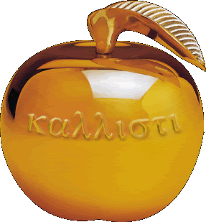
Using Negative hash codes: yellkey.com/above
Suppose that ‘s hash code is -1.
Philosophically, into which bucket is it most natural to place this item?
0
1
2
3

Slide 81
Using Negative hash codes
Suppose that ‘s hash code is -1.
Philosophically, into which bucket is it most natural to place this item?
I say 3, since -1 → 3, 0 → 0, 1 → 1, 2 → 2, 3 → 3, 4 → 0, ...
0
1
2
3
-1

Slide 82
Using Negative hash codes in Java
Suppose that ‘s hash code is -1.
Unfortunately, -1 % 4 = -1. Will result in index errors!
Use Math.floorMod instead.
public class ModTest {
public static void main(String[] args) {
System.out.println(-1 % 4);
System.out.println(Math.floorMod(-1, 4));
}
}
0
1
2
3
$ java ModTest
-1
3

Slide 83
Hash Tables in Java
Java hash tables:
Data is converted by the hashCode method an integer representation called a hash code.
The hash code is then reduced to a valid index, using something like the floorMod function, e.g. Math.floorMod(1732557 % 4) = 8.
0
1
2
3
đậu hũ
data
hash function
hash code
a
포옹
kamala lifefully
bee
đậu hũ
hashCode()
-2108180664
Math.floorMod(x, 4)
0
reduce
index

Slide 84
Two Important Warnings When Using HashMaps/HashSets
Warning #1: Never store objects that can change in a HashSet or HashMap!
Such objects are also called “mutable” objects, e.g. they can change.
Example: You’d never want to make a HashSet<List<Integer>>.
If an object’s variables changes, then its hashCode changes. May result in items getting lost.
Warning #2: Never override equals without also overriding hashCode.
Can also lead to items getting lost and generally weird behavior.
HashMaps and HashSets use equals to determine if an item exists in a particular bucket.
We’ll come back to these warnings later.

Slide 85
Hash Table Performance and Summary
Motivation, Set Implementations
Deriving Hash Tables
WriteItOnTheWallSet
BobaCounterSet
DynamicArrayOfListsSet
lowercase strings
Integer Overflow
Hash Codes
Hash Tables in Java
Hash Table Performance and Summary
Creating a Good Hash Code (extra)
Linear Probing (extra)
Lecture 19, CS61B, Spring 2024

Slide 86
Hash Table Runtime with No Resizing
Suppose we have:
An fixed number of buckets M.
An increasing number of items N.
Average list is around N/M items
0
1
2
3
4
N = 19 M = 5 N / M = 3.8
Even if items are spread out evenly, lists are of length Q = N/M.
For M = 5, that means Q = Θ(N). Results in linear time operations.

Slide 87
Resizing Hash Table Runtime
Suppose we have:
An increasing number of buckets M.
An increasing number of items N.
As long as M = Θ(N), then O(N/M) = O(1).
0
1
2
3
4
N = 19 M = 5 N / M = 3.8
Assuming items are evenly distributed (as above), lists will be approximately N/M items long, resulting in Θ(N/M) runtimes.
By doubling every time N gets too big, we ensure that N/M = O(1).
Thus, worst case runtime for all operations is Θ(N/M) = Θ(1).
… unless that operation causes a resize.
… and again, we’re assuming even distribution of items.

Slide 88
Regarding Even Distribution
Even distribution of item is critical for good hash table performance.
Both tables below have load factor of N/M = 1.
Left table is much worse!
Contains is Θ(N) for x.
Will need to discuss how to ensure even distribution.
See extra video and slides for more on ensuring an even distribution.
x
x

Slide 89
Hash Tables in Java
Hash tables:
Data is converted into a hash code.
The hash code is then reduced to a valid index.
Data is then stored in a bucket corresponding to that index.
Resize when load factor N/M exceeds some constant.
If items are spread out nicely, you get Θ(1) average runtime.
 | contains(x) | add(x)
Bushy BSTs | Θ(log N) | Θ(log N)
Separate Chaining Hash Table With No Resizing | Θ(N) | Θ(N)
… With Resizing | Θ(1)† | Θ(1)*†
data
hash function
hash code
đậu hũ
hashCode()
-2108180664
Math.floorMod(x, 4)
0
reduce
index
*: Amortized.
†: Assuming items are evenly spread.

Slide 90
Creating a Good Hash Code (extra)
Motivation, Set Implementations
Deriving Hash Tables
WriteItOnTheWallSet
BobaCounterSet
DynamicArrayOfListsSet
lowercase strings
Integer Overflow
Hash Codes
Hash Tables in Java
Hash Table Performance and Summary
Creating a Good Hash Code (extra)
Linear Probing (extra)
Lecture 19, CS61B, Spring 2024

Slide 91
What Makes a good .hashCode()?
Goal: We want hash tables that look like the table on the right.
Want a hashCode that spreads things out nicely on real data.
Example #1: return 0 is a bad hashCode function.
Example #2: just returning the first character of a word, e.g. “cat” → 3 was also a bad hash function.
Example #3: Adding chars together is bad. “ab” collides with “ba”.
Example #4: returning string treated as a base B number can be good.
Writing a good hashCode() method can be tricky.

Slide 92
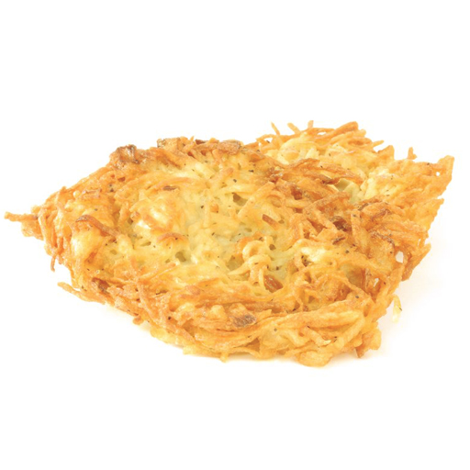
Hashbrowns and Hash Codes
How do you make hashbrowns?
Chopping a potato into nice predictable segments? No way!
Similarly, adding up the characters is not nearly “random” enough.
Can think of multiplying data by powers of some base as ensuring that all the data gets scrambled together into a seemingly random integer.
Notes:
https://cookingplanit.com/public/uploads/inventory/hashbrown_1366322674.jpg

Slide 93
Example hashCode Function
The Java 8 hash code for strings. Two major differences from our hash codes:
Represents strings as a base 31 number.
Why such a small base? Real hash codes don’t care about uniqueness.
Stores (caches) calculated hash code so future hashCode calls are faster.
@Override
public int hashCode() {
int h = cachedHashValue;
if (h == 0 && this.length() > 0) {
for (int i = 0; i < this.length(); i++) {
h = 31 * h + this.charAt(i);
}
cachedHashValue = h;
}
return h;
}

Slide 94
Example: Choosing a Base
Java’s hashCode() function for Strings:
h(s) = s₀ × 31^{n-1} + s₁ × 31^{n-2} + … + s_{n-1}
Our asciiToInt function for Strings:
h(s) = s₀ × 126^{n-1} + s₁ × 126^{n-2} + … + s_{n-1}
Which is better?
Might seem like 126 is better. Ignoring overflow, this ensures a unique numerical representation for all ASCII strings.
… but overflow is a particularly bad problem for base 126!

Slide 95
Example: Base 126
Major collision problem:
“geocronite is the best thing on the earth.”.hashCode() yields 634199182.
“flan is the best thing on the earth.”.hashCode() yields 634199182.
“treachery is the best thing on the earth.”.hashCode() yields 634199182.
“Brazil is the best thing on the earth.”.hashCode() yields 634199182.
Any string that ends in the same last 32 characters has the same hash code.
Why? Because of overflow.
Basic issue is that 126^32 = 126^33 = 126^34 = ... 0.
Thus upper characters are all multiplied by zero.
See CS61C for more.

Slide 96
Typical Base
A typical hash code base is a small prime.
Why prime?
Never even: Avoids the overflow issue on previous slide.
Lower chance of resulting hashCode having a bad relationship with the number of buckets: See study guide problems and hw3.
Why small?
Lower cost to compute.
A full treatment of good hash codes is well beyond the scope of our class.

Slide 97
Hashbrowns and Hash Codes
How do you make hashbrowns?
Chopping a potato into nice predictable segments? No way!
Using a prime base yields better “randomness” than using something like base 126.
Notes:
https://cookingplanit.com/public/uploads/inventory/hashbrown_1366322674.jpg

Slide 98
Example: Hashing a Collection
Lists are a lot like strings: Collection of items each with its own hashCode:
To save time hashing: Look at only first few items.
Higher chance of collisions but things will still work.
@Override
public int hashCode() {
int hashCode = 1;
for (Object o : this) {
hashCode = hashCode * 31;
hashCode = hashCode + o.hashCode();
}
return hashCode;
}
elevate/smear the current hash code
add new item’s hash code

Slide 99
Example: Hashing a Recursive Data Structure
Computation of the hashCode of a recursive data structure involves recursive computation.
For example, binary tree hashCode (assuming sentinel leaves):
@Override
public int hashCode() {
if (this.value == null) {
return 0;
}
return this.value.hashCode() +
31 * this.left.hashCode() +
31 * 31 * this.right.hashCode();
}

Slide 100
Linear Probing (extra)
Motivation, Set Implementations
Deriving Hash Tables
WriteItOnTheWallSet
BobaCounterSet
DynamicArrayOfListsSet
lowercase strings
Integer Overflow
Hash Codes
Hash Tables in Java
Hash Table Performance and Summary
Creating a Good Hash Code (extra)
Linear Probing (extra)
Lecture 19, CS61B, Spring 2024

Slide 101
Open Addressing: An Alternate Disambiguation Strategy (Extra)
Instead of using linked lists, an alternate and more exotic strategy is “open addressing”.
Set is stored as an array of items. Index tells you where to put the item.
If target location is already occupied, use a different location, e.g.
Linear probing: Use next address, and if already occupied, just keep scanning one by one.
Demo: http://goo.gl/o5EDvb
Quadratic probing: Use next address, and if already occupied, try looking 4 ahead, then 9 ahead, then 16 ahead, …
Many more possibilities. See the optional reading for today (or CS170) for a more detailed look.
In 61B, we’ll use the “separate chaining” approach, where we have linked lists.

Slide 102
Citations
http://www.nydailynews.com/news/national/couple-calls-911-forgotten-mcdonalds-hash-browns-article-1.1543096
http://en.wikipedia.org/wiki/Pigeonhole_principle#mediaviewer/File:TooManyPigeons.jpg
https://cookingplanit.com/public/uploads/inventory/hashbrown_1366322674.jpg

Slide 103
FAQ
What is the distinction between hash set, hash map, and hash table?
A hash set is an implementation of the Set ADT using the “hash table” as its engine.
A hash map is an implementation of the Map ADT using the “hash table” as its engine.
A “hash table” is a way of storing information, where you have M buckets that store N items. Each item has a “hashCode” that tells you which of M buckets to put that item in.

